Slide 1
PREDICTING COMPANY FAILURE
BRIGITTE WETZ
COLORADO STATE UNIVERSITY GLOBAL
MIS581: CAPSTONE - BUSINESS INTELLIGENCE AND DATA ANALYTICS
DR. JAMIA MILLS
JULY 7, 2024

Slide 2
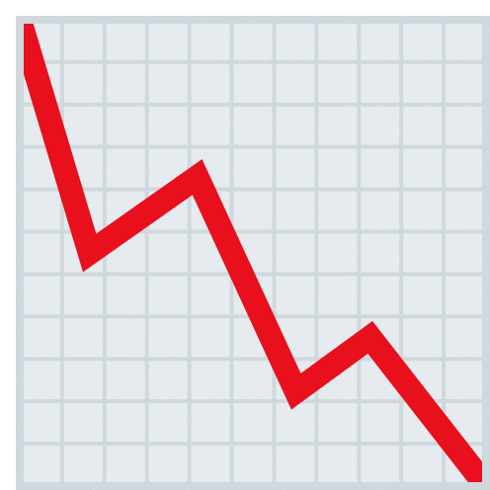
CAN COMPANY FAILURE BE PREDICTED?
Objectives
Data
Methods
Findings
Statistical Analysis
Machine Learning Models
Limitations & Recommendations
Figure 1
Declining Graph
Notes:
This study sought to find variables which correlate with companies filing for bankruptcy and then sought to determine if bankruptcy fillings could be predicted with machine learning based on these variables.

Slide 3
RESEARCH OBJECTIVES
Determine if any variables correlate with companies filing for bankruptcy
Determine if machine learning models can predict if a company is going to file for bankruptcy
Notes:
Knowing which, if any, variables are correlated with a company filing for bankruptcy is beneficial for both company and investor. If a company can recognize circumstances which could lead to potential bankruptcy, it can make changes before that occurs, while if an investor who owns stock in a company recognizes signs related to a company potentially failing, he or she can withdraw or sell stock to preserve his or her capital and prevent personal financial loss. Financial institutions regularly calculate financial ratios using a company’s financial statements to determine credit worthiness and if a loan warrants a higher interest rate when a company wishes to refinance. If a company’s financial ratios become undesirable compared to an industry average, whether too high or too low, it may be harder for companies to obtain new funding (McGregor, 2022).

Slide 4
DATA
Annual GDP Growth Rate (World Bank)
Annual Consumer Price Index (U.S. Bureau of Labor Statistics)
Financial statement data (‘yfinance’ library)
Currently active companies trading on the stock market
Companies which have filed for bankruptcy in the past four years
Notes:
The World Bank provides global GDP growth rate information which was downloaded as a spreadsheet. GDP is a measure of the yearly value of goods and services produced in a country and can indicate how well a country’s economy is performing and can help identify recessions when the growth contracts compared to the previous timeframes. The U.S. Bureau of Labor Statistics provides monthly inflation data which was downloaded as a spreadsheet and the annual average inflation rate calculated. Companies must file financial statements with the United States government on a quarterly and annual basis and this data can be used to compute financial ratios which are indicators of a company’s financial health. Country specific data such as GDP and inflation can affect companies negatively when GDP contracts or when inflation increases. The cost of goods and services increases and consumers spend less which can result in less revenue for companies. The ‘yfinance’ library in Python provides cash flow statements, income statements, and balance sheets which were used for the calculation of financial ratios.

Slide 5
METHODS
Import GDP, CPI, and stock ticker spreadsheets into Jupyter Notebook
Pull financial statement data for each stock ticker for the past four years
Calculate financial ratios
Statistical analysis
Machine learning models (‘scikit-learn’ library)
Notes:
Liquidity ratios such as the current ratio indicate if a company can pay its short- and long-term obligations in a timely manner. Leverage ratios such as debt-to-equity determine how a company finances its operations, either through loans from financial institutions or via stock offerings/shareholders. Profitability ratios, such as return on assets, determine how well a company can generate income relative to revenue or operating costs.
Ten financial ratios were computed: current, acid-test, working capital, debt, debt-to-equity, interest coverage, return on assets, return on equity, earnings per share, and return on total assets.

Slide 6
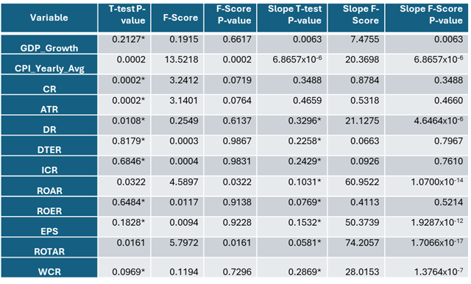
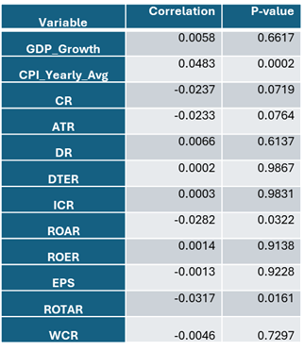
STATISTICAL ANALYSIS
5,766 datapoints for non-bankrupt years, 15 datapoints for bankruptcies
Table 1
Results of T-Tests and ANOVA
Table 2
Point-Biserial Correlation Results
Note. Values with an (*) indicate Welch’s t-test
Notes:
Once financial ratios were calculated, only records with a full suite of ratios were kept and the financial statement data was dropped from the dataframe. The final analysis consisted of these ten ratios plus GDP and CPI data for a total of twelve variables.Two correlation techniques were used: Point-Biserial Correlation and two-sample t-test (normal and Welch) to determine p-values. Point-Biserial Correlation measures how much two variables are associated with one another and can be used on data with unequal variances (Bonett, 2020) while two-sample t-tests compare the statistical significance between the means of two independent groups or populations (JMP, n.d.). P-values measure the probability of the current value of the coefficient being the same if the two variables were unrelated. Common practice is to state that if a p-value is below 0.05, then the two variables have a statistically significant relationship with one another. Mini linear regression models were created for each company to calculate the slope for each variable and statistical analysis between bankrupt and non-bankrupt companies was performed to determine if the degree of decreasing or increasing values for the variables was an indicator of financial trouble. The tests show that for this dataset, the slope is not an indicator for most of the variables with the exception of GDP and CPI based on the t-test p-values falling above 0.05. If the significance threshold were to be increased, it is possible to consider the slopes for Return on Equity and Return on Total Assets as potential variables to add to the machine learning models.

Slide 7
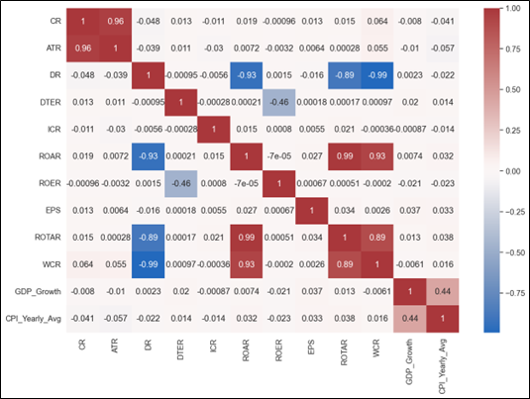
FEATURE SELECTION
Based on statistical analysis and correlation matrix, four variables were selected for machine learning:
Current Ratio
Debt Ratio
Return on Assets Ratio
CPI
Figure 2
Correlation Matrix Heatmap
Notes:
A correlation matrix was constructed to view how strong of a correlation exists between variables. When two variables are highly correlated, including both in a model will cause issues in the p-values and confidence intervals, leading to a model which is not an accurate depiction of the predictive nature of the model (Singh et al., 2023). The correlation matrix shows a high degree of correlation (Pearson coefficient) between Current Ratio and Acid-test Ratio, Debt Ratio and Working Capital Ratio, Return on Assets and Return on Total Assets, Return on Assets and Working Capital, and Return on Assets and Debt Ratio.

Slide 8
MACHINE LEARNING MODELS
Logistic Regression
Support Vector Machine
XGBoost
Artificial Neural Network
Notes:
Some machine learning models, such as logistic regression, perform best when data is normally distributed. Therefore, each variable was analyzed for skewness and kurtosis. Those variables which are not normally distributed may be scaled in Python. Any variables with large variances will also require scaling. ANN, and SVM do not require normally distributed data for models to perform well but do require scaling. Scaling was done using the RobustScaler in ‘scikit-learn.’
Precision, recall, F1-score, and ROC curves were used to evaluate the predictive performance of each model. Shapley Additive exPlanations (SHAP) is another technique for evaluating variables and their effect on the target outcome (Mickle & Deb, 2022).
Each model was created using a test train split of 70% to 30%.

Slide 9
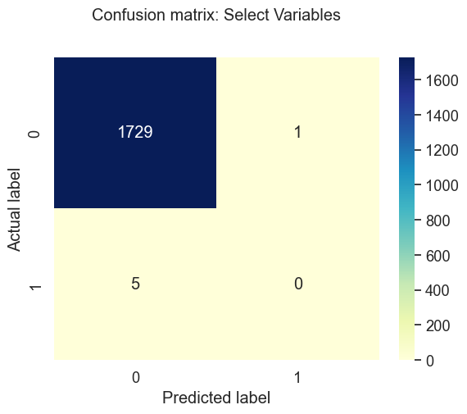
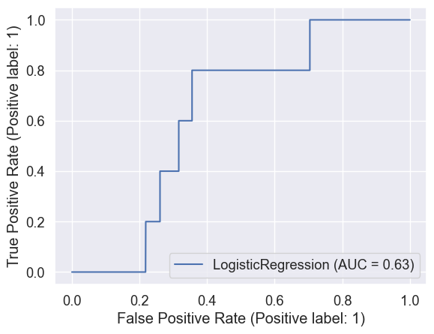
LOGISTIC REGRESSION
Accuracy = 99.65%; Precision & Recall = N/A
Figure 3
Confusion Matrix
Figure 4
ROC AUC Curve
Notes:
Logistic Regression models have been widely used since the 1940’s due to their ease of building and interpretation. It predicts the probability of a target outcome to be either 0 or 1. Figure 3 shows the confusion matrix for this model while Figure 4 shows the ROC curve. A confusion matrix plots the number of true positives, true negatives, false positives, and false negatives when the model uses the test data set. Accuracy is simply the number of correct answers divided by the total number of data points. Recall, also referred to as sensitivity, measures the number of true positives divided by the total number of actual positives. Precision is the number of true positives divided by the number of predicted positives. In this case, that number is 0 and therefore the precision and recall for bankrupt companies in this model is 0. Receiver Operating Characteristic curve plots true positive rates versus false positive rates. When the area under the curve approaches 1, the better the model is at predicting bankruptcies.

Slide 10

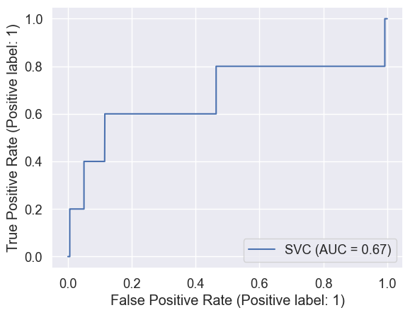
SUPPORT VECTOR MACHINE
Accuracy = 99.71%; Precision & Recall = N/A
Figure 5
Confusion Matrix
Figure 6
ROC AUC Curve
Notes:
Support Vector Machines calculate a hyperplane that best classifies the target outcome.

Slide 11

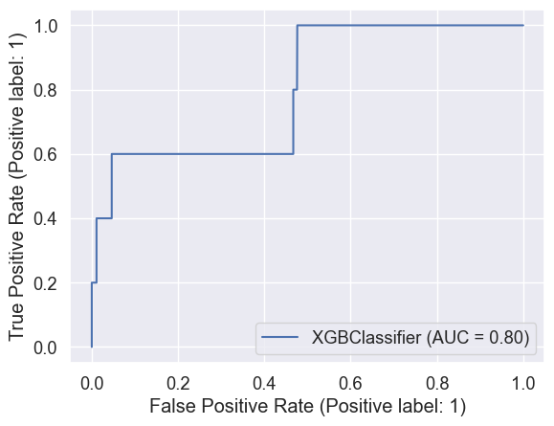
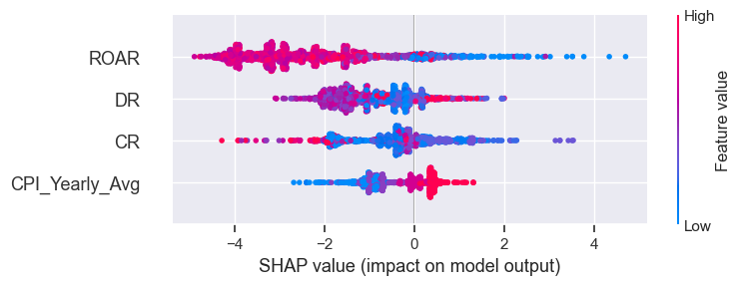
XGBOOST
Accuracy = 99.77%; Precision = 1, Recall = 0.2
Figure 7
Confusion Matrix
Figure 8
ROC AUC Curve
Figure 9
SHAP Values
Notes:
XGBoost iteratively builds decision trees, tweaking each one to find the best fitting model based on what the user selects as the evaluation criteria (in this case it is AUC). This model has the highest accuracy so far and was able to correctly predict a bankrupt company. This is what gives us a precision value of 1 and a recall value of 0.2. Figure 9 shows the Shapley values for each variable. Shapley Additive exPlanations (SHAP) is another technique for evaluating variables and their effect on the target outcome (Mickle & Deb, 2022). SHAP analysis shows that higher values of the Return on Assets Ratio indicate companies are less likely to file for bankruptcy, while higher CPI values are an indication that a company is more likely to file for bankruptcy.

Slide 12
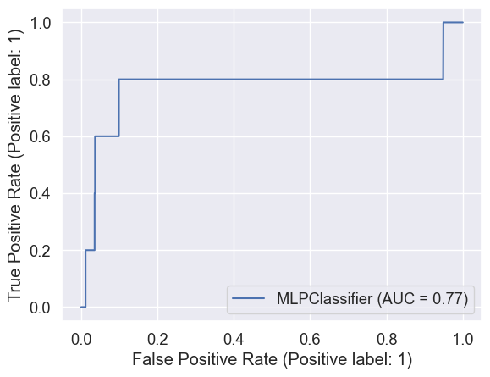
ARTIFICIAL NEURAL NETWORK
Accuracy = 99.71%; Precision & Recall = N/A
Figure 10
Confusion Matrix
Figure 11
ROC AUC Curve
Notes:
Artificial Neural Networks are intended to mimic the neurons in the brain by finding connections based on interconnected nodes and hidden layers. It is the most black-box of the models and can be difficult to interpret from a variable standpoint. Three layers with five hidden units was used for this model. This model is great at handling non-linear and/or complicated relationships.

Slide 13
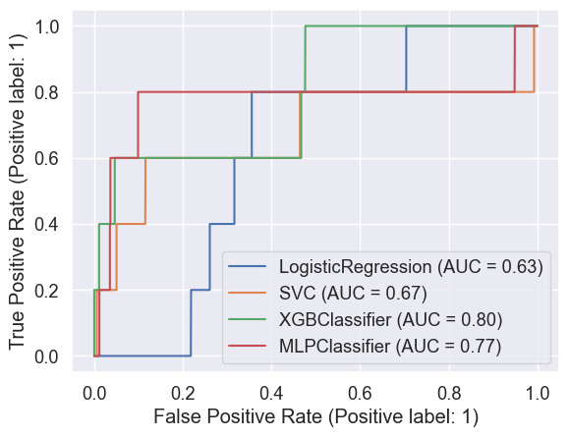
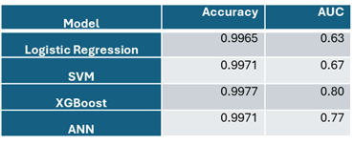
CONCLUSION
XGBoost was the model with the highest accuracy, AUC, precision, and recall.
Figure 12
ROC AUC Curves for All Models
Table 3
Summary of Machine Learning Models
Notes:
XGBoost was the model with the highest accuracy, AUC, precision, and recall.

Slide 14
LIMITATIONS AND RECOMMENDATIONS
Data
Time
Other libraries
Combination models
Notes:
Python’s ‘yfinance’ library did not have as much information as expected, seen by the low number of records for companies which have filed for bankruptcy (15). This could have resulted in overfitting in the models. While annual data was used to represent a company’s financial health the year of bankruptcy filing, quarterly data is also available and would add a level of granularity to the analysis. Another library available in Python is the ‘edgartools’ library which also pulls financial statement data from the SEC but for a longer time period. This library may contain more data for use in the analysis resulting in more data points. While attempts were made to drop outliers outside of three standard deviations, no data was dropped in this method so it might be worth to drop data based on value cutoffs regardless of standard deviations from the mean. Only four simple models were created and it’s possible a combination model could outperform the ones created in this study. Combination models such as clustering and logistic regression have been used with success in other industries and it would be interesting to apply that style to this study (Li, 2016).

Slide 15
REFERENCES
Bonett, D. G. (2020). Point‐biserial correlation: Interval estimation, hypothesis testing, meta‐analysis, and sample size determination. British Journal of Mathematical & Statistical Psychology, 73, 113–144. https://doi.org/10.1111/bmsp.12189
JMP. (n.d.). The t-Test. JMP. https://www.jmp.com/en_us/statistics-knowledge-portal/t-test.html
Li, J., Weng, J., Shao, C., & Guo, H. (2016). Cluster-Based Logistic Regression Model for Holiday Travel Mode Choice. Procedia Engineering, 137(2016), 729-737. https://www.sciencedirect.com/science/article/pii/S1877705816003374?via%3Dihub
McGregor, R. (2022, September 30). The 4 main reasons why you should care about financial ratios. CPA. https://www.bccpa.ca/news-events/cpabc-newsroom/2022/september/the-4-main-reasons-why-you-should-care-about-financial-ratios/
Mickle, C. F., & Deb, D. (2022). Early prediction of patient discharge disposition in acute neurological care using machine learning. BMC Health Services Research, 22(1), 1–15. https://doi.org/10.1186/s12913-022-08615-w
Singh, P., Singh, S., & Paprzycki, M. (2023). Detection and elimination of multicollinearity in regression analysis. International Journal of Knowledge Based Intelligent Engineering Systems, 27(1), 105–111. https://doi.org/10.3233/KES-221622

